Slide 1


SAP UI5 & FIORI with OData TRAINING using BAS
Shekhar Vedi
Day – 13

Slide 2

Agenda – Day 13
Design OData Service entities using service generation technique
Define Order Entity
Define Order Items
Implement Service
Implementing the DEEP ENTITY
Testing DEEP ENTITY and INSERT
Understand Fiori Yoman tooling

Slide 3
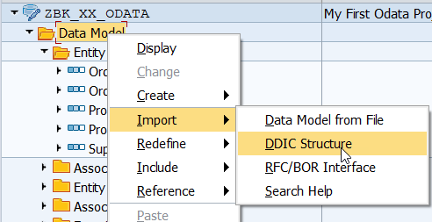
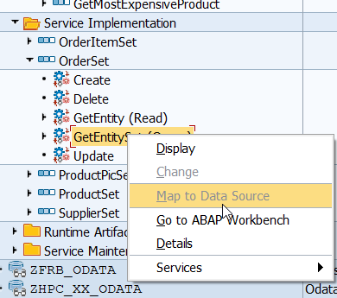
Service Generation Technique
In order to speed up the definition of the OData services, we can use the service generation technique. Most of the metadata definition and code will be auto generated by SAP system in such case.
The steps to use service generation are as below
Right click on data model and choose import -> DDIC Structure
Provide the order structure as BAPI_EPM_SO_HEADER
Repeat the step 2 for Order Item entity for DDIC structure BAPI_EPM_SO_ITEM
We can use the service generation technique to map to the data source as BAPI - BAPI_EPM_SO_GET_LIST
Once we generate the code, we can overwrite same in DPC_EXT class
Implement an association between header and items
Source Code for Header GET ALL
Source Code for Associated Items

Slide 4
Implementing the DEEP ENTITY
SAP Gateway Deep Inset allows to store hierarchical data like in our case Sales Order that has both header and item data (one can not exist without another).
Deep Inset is an opposite to $expand URI option.
With the help of Deep Entity we can implement deep inserts in SAP OData Services.
We need to include a new structure in the MPC class to support the DEEP ENTITY
Deep Entity Structure Definition
Implementation Logic for /IWBEP/IF_MGW_APPL_SRV_RUNTIME~CREATE_DEEP_ENTITY
types : BEGIN OF TS_DEEP_ENTITY .
INCLUDE TYPE TS_ORDER.
TYPES : TO_ITEMS type standard table of TS_ORDERITEM WITH DEFAULT KEY,
END OF TS_DEEP_ENTITY.

Slide 5
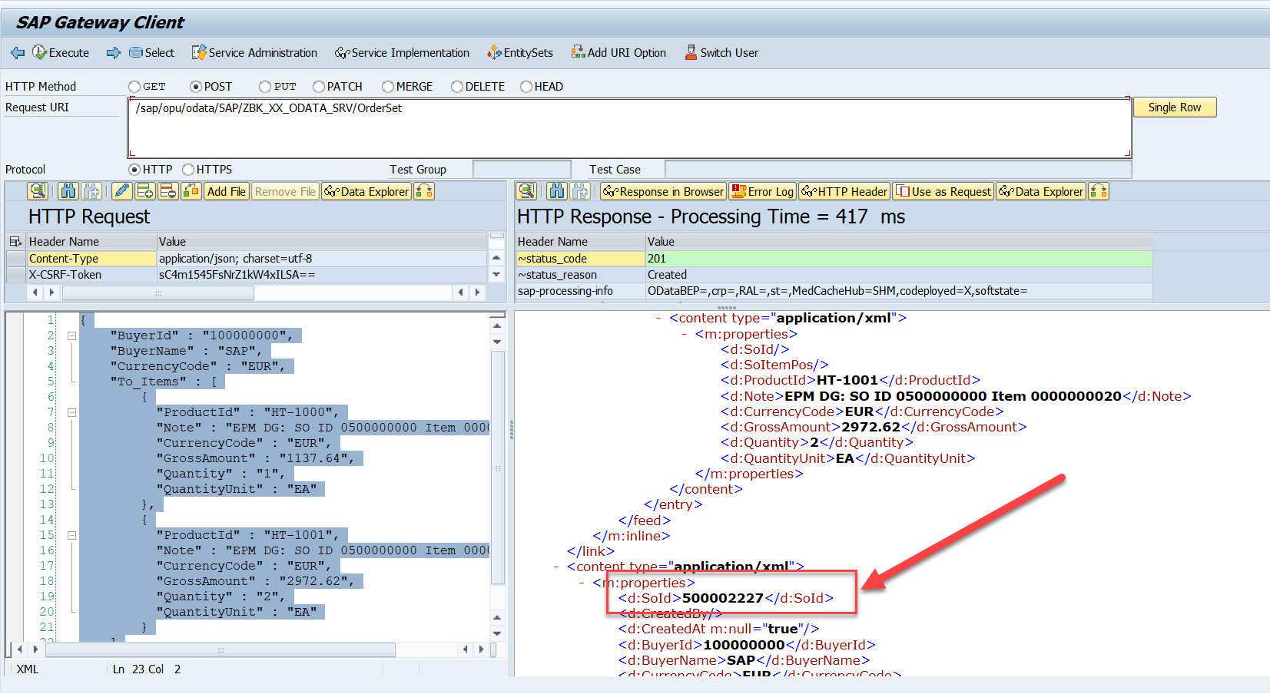
Testing DEEP ENTITY and INSERT
We can now test the deep insert with mass upload payload as below
Payload sample

Slide 6

Working with DEEP Inserts on Fiori App
Yeoman helps you to kickstart new projects, prescribing best practices and tools to help you stay productive.
To do so, it provide a generator ecosystem. A generator is basically a plugin that can be run with the `yo` command to scaffold complete projects or useful parts.
We can discover pre-built generators as below
https://yeoman.io/generators/
Steps
Install yeoman tool – npm install –g yo
Install generator – npm install –g anubhav-basicfiori
We can use the generator in VS Code or BAS to create new project

Slide 7

End of Day 13

Slide 8

Questions

Slide 9

Shekhar Vedi

Slide 10


We’re committed to empower you to be
Most Desirable Resource
through powerful training solutions.
We build the workforce of the future.
250+
Corporate Clients
30,000+
Learners Trained
25000+
Learners Placed
FREE WEBINARS
Sign up for free webinars with industry experts every fortnight!
Enroll Now!
Contact us today!
https://anubhavtrainings.com/

Slide 11




More from AnubhavTrainings.com

Slide 12
Title
Content

